Slide 1
Segmentation Review tool updates
Benjamin Green

Slide 2
Overview
Updates
Review the ‘highly overlapped’ cells again
Review what happens when separate cells overlap in the final segmentation
Talk about next steps for analysis

Slide 3
Overview
Updates
Review the ‘highly overlapped’ cells again
Review what happens when separate cells overlap in the final segmentation
Talk about next steps for analysis

Slide 4

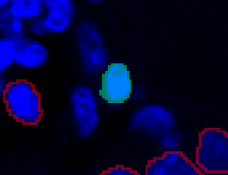
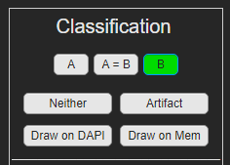
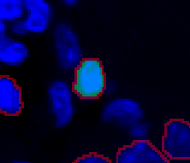
Applied Segmentation
We have two views in the segmentation now
The ‘Toggle Seg’ shows the original segmentation for ‘A’ or ‘B’, respectively
The ‘applied segmentation’ shows the segmentation that has been accepted by the user and is updated in real time
When the user selects or draws a cell the outline is added to the ‘applied segmentation’

Slide 5

“Highly Joint Overlapped Cells”
Computed as having a joint overlap higher than .8
$\frac{pixels of A which overlap with B}{{Total pixels}_{A}}$ * $\frac{pixels of B which overlap with A}{{Total pixels}_{B}}$
Previously accepted as positive => Needed a way to review these cells

Slide 6
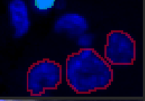
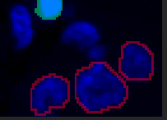
Current Solution
Add the other 80% to the applied segmentation so that when the user reviews, they see these as accepted cells
Compute number of pairs with joint overlap (JO) of greater than .8
Randomly choose 20% of these for review (call this the JO review group)
The user will only notice this since there will be more cells in the ‘applied segmentation’ than have been accepted
This should really only be noticeable at the beginning
I felt like adding these cells at this time gave the user a little more context in this view
Notes:
I thought it would be good to talk about the information I am keeping from the slides so that we are all on the same page.

Slide 7
Current Solution Cont.
Add the other 80% to the applied segmentation so that when the user reviews, they see these as accepted cells
Add the other 80% to the applied segmentation so that when the user reviews, they see these as accepted cells
Compute number of pairs with joint overlap (JO) of greater than .8
Randomly choose 20% of these for review (call this the JO review group)
Compute number of pairs with joint overlap (JO) of greater than .8
Randomly choose 20% of these for review (call this the JO review group)
As the user reviews cells, we track the disagreement of this JO review group, Defined as not ‘A=B’, each time we go to a new cell
As the user reviews cells, we track the disagreement of this JO review group, Defined as not ‘A=B’, each time we go to a new cell
If at any point the user selects more than 20% of this JO review group as having disagreement.
Add the rest of the .8 overlap cells back into the review set and remove them from the ‘applied segmentation’
If at any point the user selects more than 20% of this JO review group as having disagreement.

Slide 8
Different Solution
Compute number of pairs with joint overlap (JO) of greater than .8
Randomly choose 20% of these for review (call this the JO review group)
Do not add other 80% to the applied segmentation
Add the rest of the .8 overlap cells back into the review set and review them
At the end of the review process, check if the disagreement in this this JO review group is >20%. Disagreement is defined as not ‘A=B’,
Yes / No
Review whole image
Add the rest of the .8 overlap cells to the ‘applied segmentation’

Slide 9

Issue 2: two-fold
As it stands now, cells cannot be removed
An issue for over or under segmented .8 JO pairs
or any user mistakes
Both issues ideally revealed at whole image review stage
Unsure what to do with cells that overlap after segmentation has been applied
Solutions?
Later cells are added over top of older cells, shrinking the older cells or removing them entirely
Add a button which allows the removal of object underneath

Slide 10
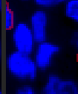
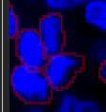
Issue 2: two-fold
As it stands now, cells cannot be removed
An issue for over or under segmented .8 JO pairs
or any user mistakes
Both issues ideally revealed at whole image review stage
Unsure what to do with cells that overlap after segmentation has been applied
Solutions?
Later cells are added over top of older cells, shrinking the older cells or removing them entirely
Add a button which allows the removal of object underneath

Slide 11
Issue 2: two-fold
As it stands now, cells cannot be removed
An issue for over or under segmented .8 JO pairs
or any user mistakes
Both issues ideally revealed at whole image review stage
Unsure what to do with cells that overlap after segmentation has been applied
Solutions?
Later cells are added over top of older cells, shrinking the older cells or removing them entirely
Add a button which allows the removal of object underneath

